Slide 1
Cellato a DSL for Cellular Automata based on C++ TemplateMeta-programming
🙋‍♂️ Matyáš Brabec
👤 Jiří Klepl
👤 Martin Kruliš

Slide 2
Cellular Automata
Special case of a stencil
Iterative simulation on a discrete grid
i-th state
(i + 1)-th state
Finite set of states
Transition rule
⚙️

Slide 3
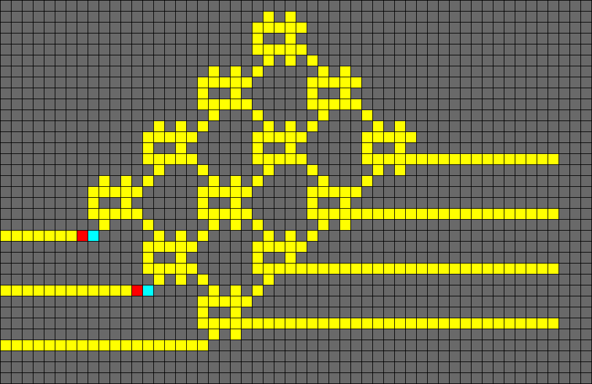
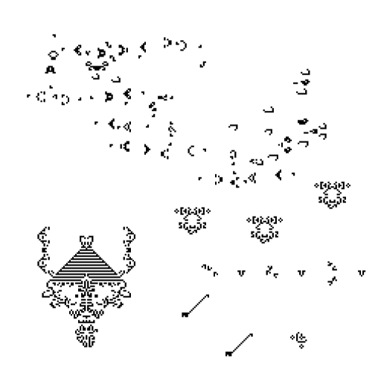
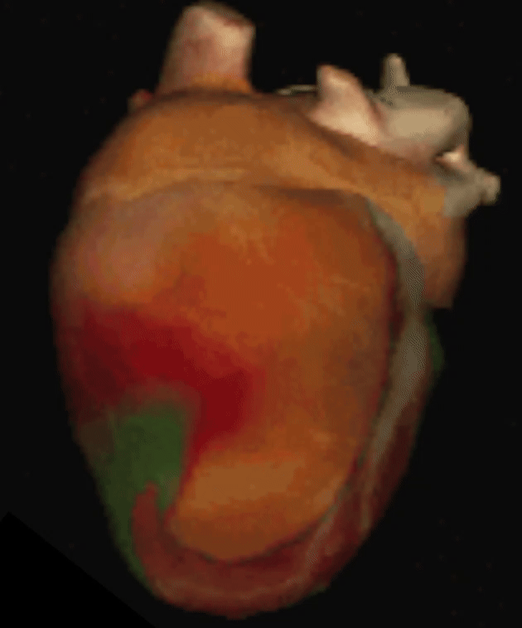
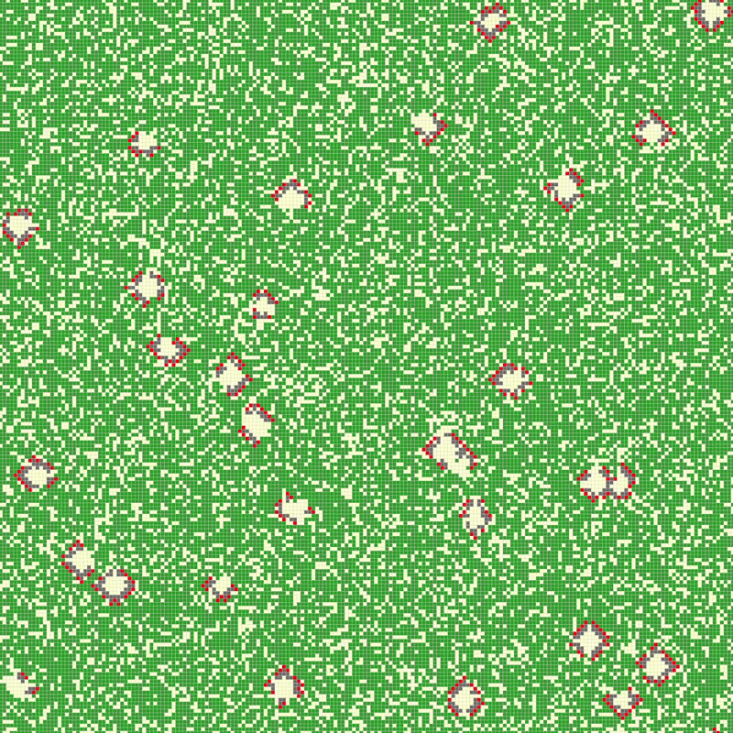

Some examples

Slide 4
Cellato Motivation
Spatial blocking
Grid is tiled
Temporal blocking
Tile with bigger halo
More steps at once
Optimalization
For stencils in general
Spatial Blocking (Loop Tiling)
Temporal Blocking
…
Cellular automata specific
Bit packed representation
Bit-wise vector-like execution
Traversal order

Slide 5
Grid for Cellular automata
Array of 32-bit integers
0
1
2
3
0
☠️
☠️
☠️
☠️
1
☠️
☠️
☠️
☠️
…
2
☠️
☠️
☠️
☠️
3
☠️
☠️
☠️
☠️
…

Slide 6
Grid for Cellular automata
Bit packing – more states in 32-bit integer
0
… 15
16
… 31
31
… 63
31
… 3
0
…
…
…
…
1
…
…
…
…
…
2
…
…
…
…
3
…
…
…
…
…

Slide 7
Grid for Cellular automata
x
x
x
0 1 0
y
0
0
y
1
1
y
0
0
2-nd
1-st
Bit plane
0-th

Slide 8
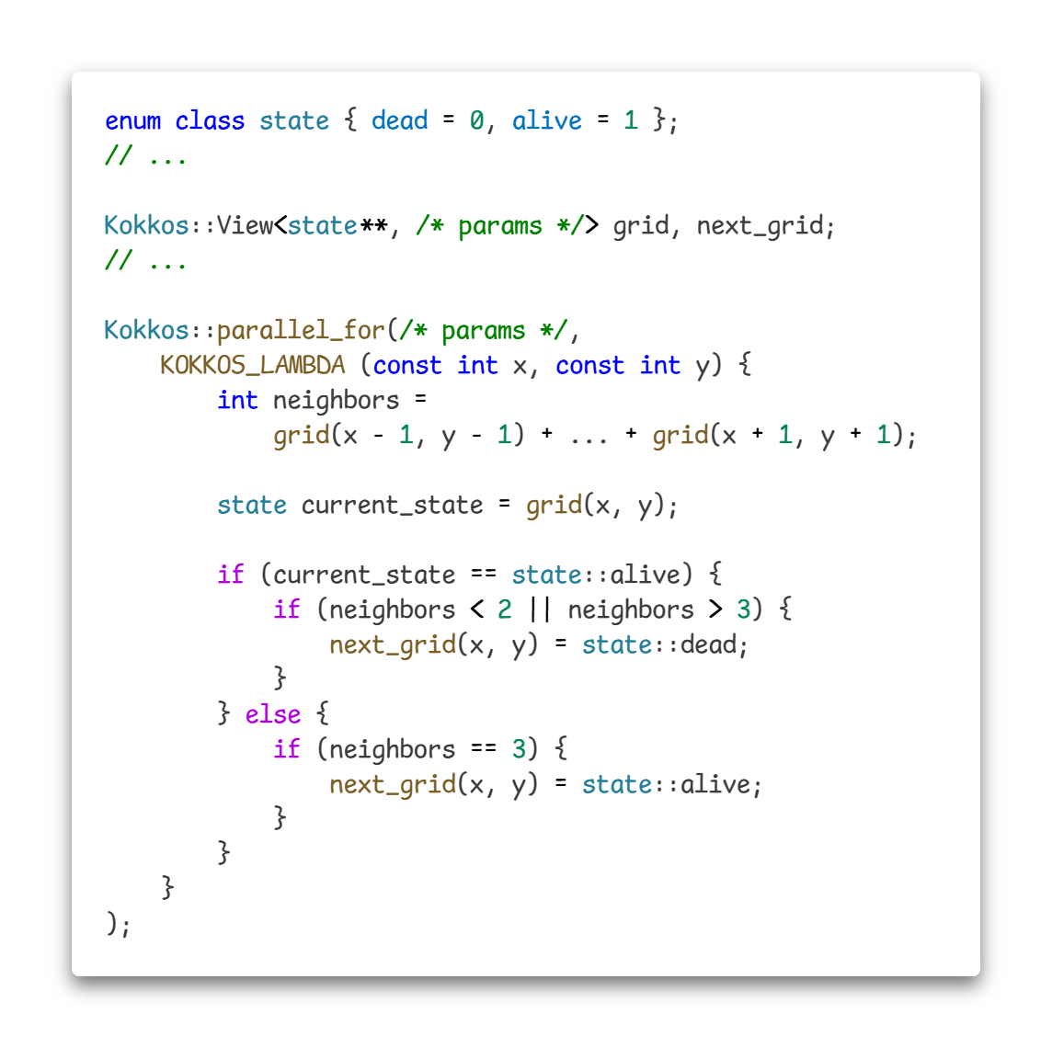
Classical Stencil framework
User defines update rule
Traversing the grid handled
Kokkos example

Slide 9
Cellato language
Type-level Expression Language

Slide 10
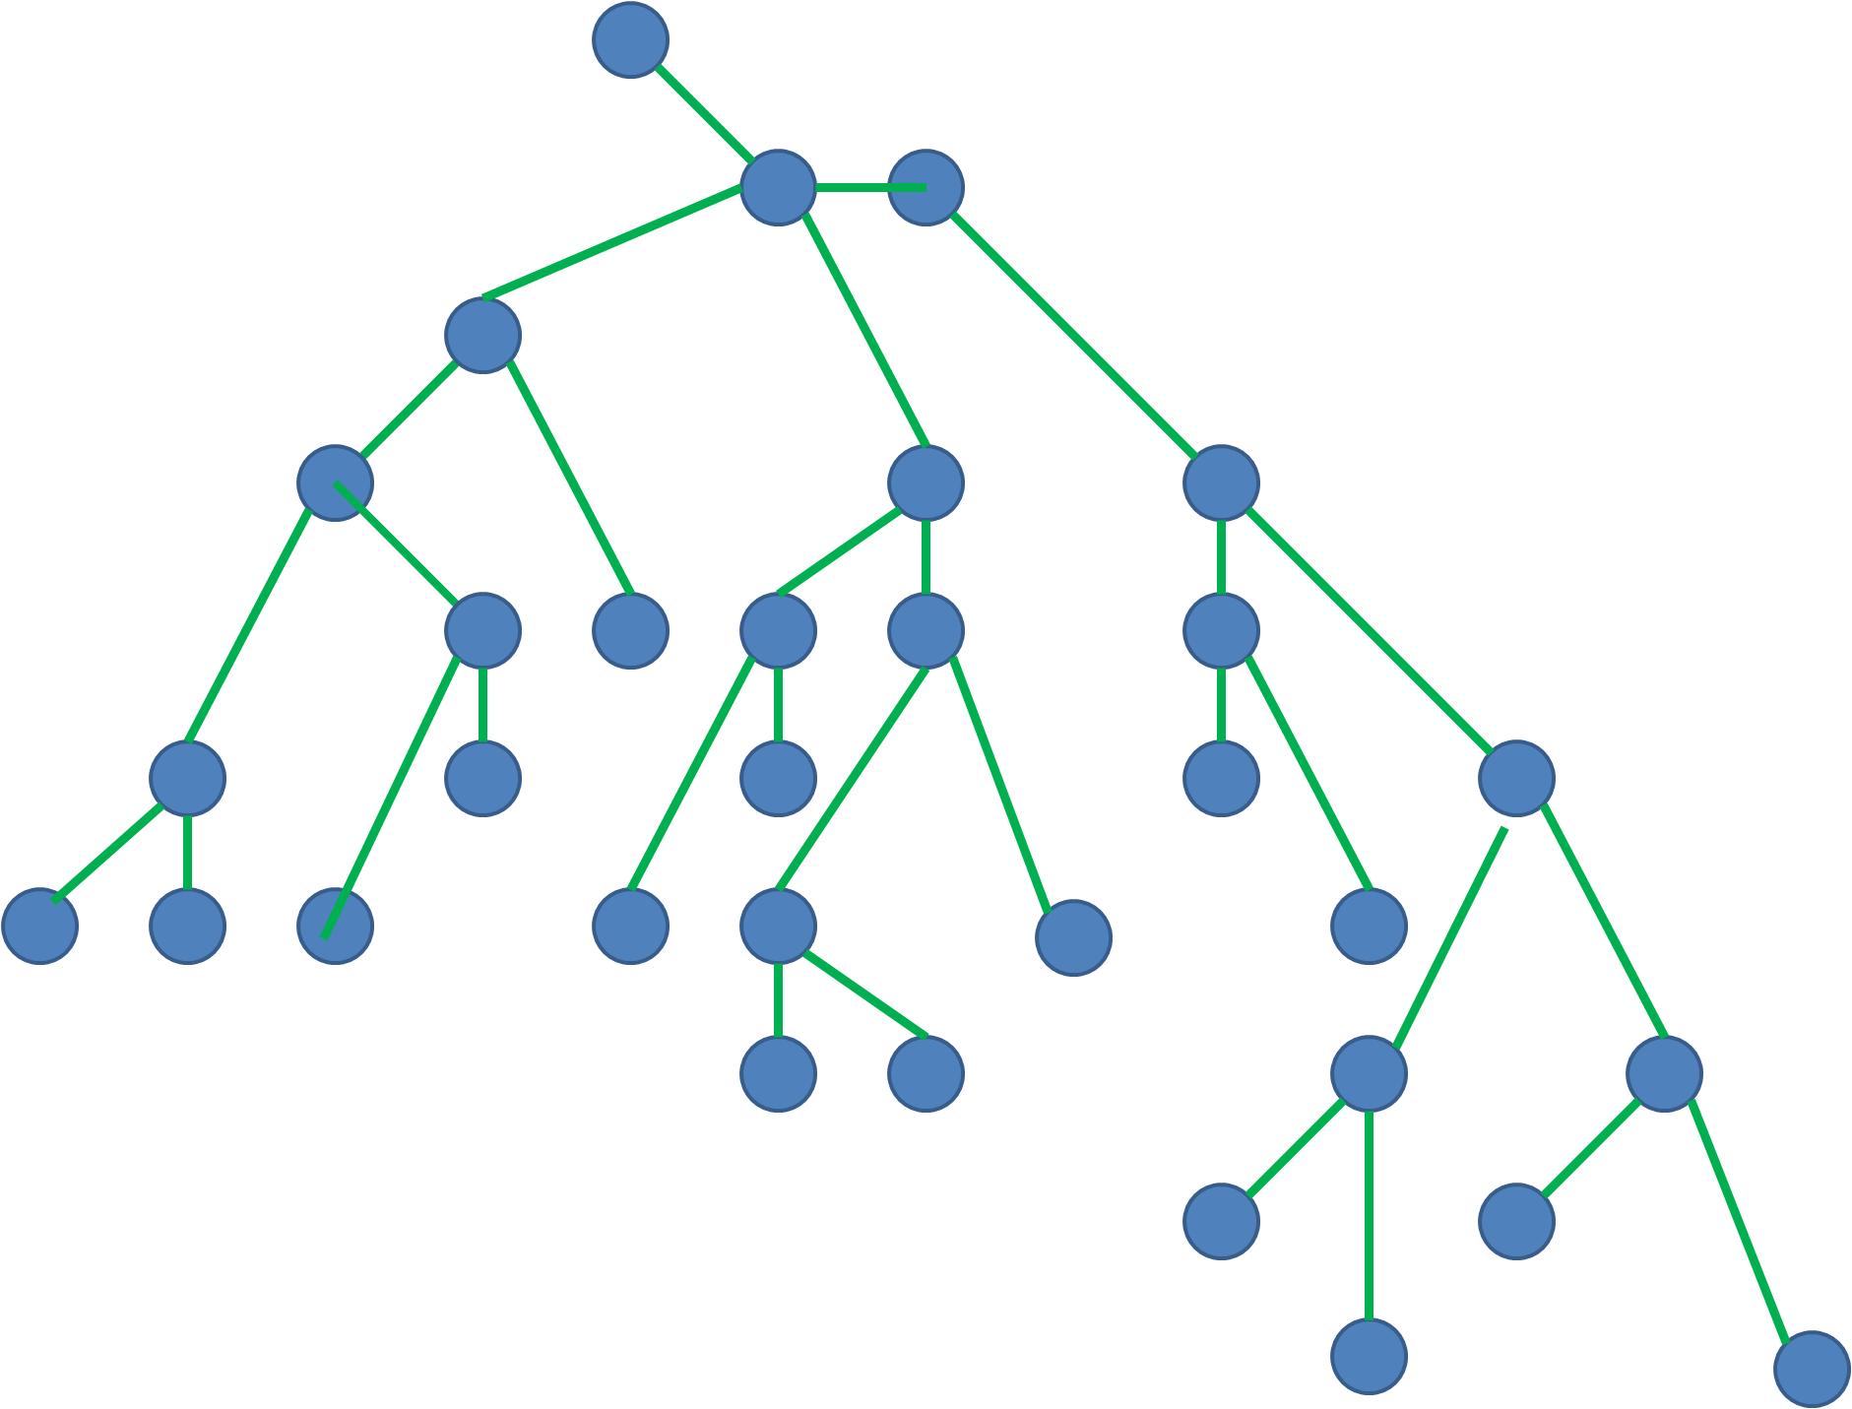
Cellato language
Type-level Expression Language
Abstract Syntax Tree
≈
⚙️

Slide 11
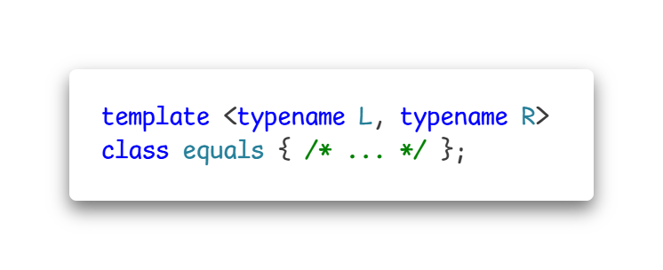
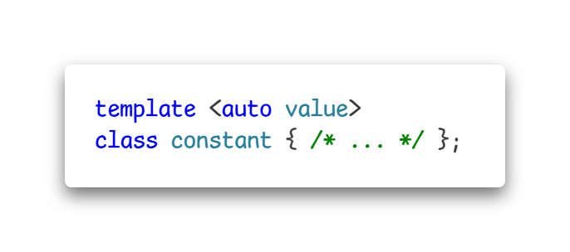
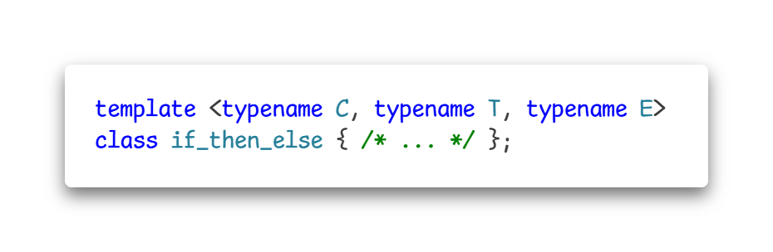
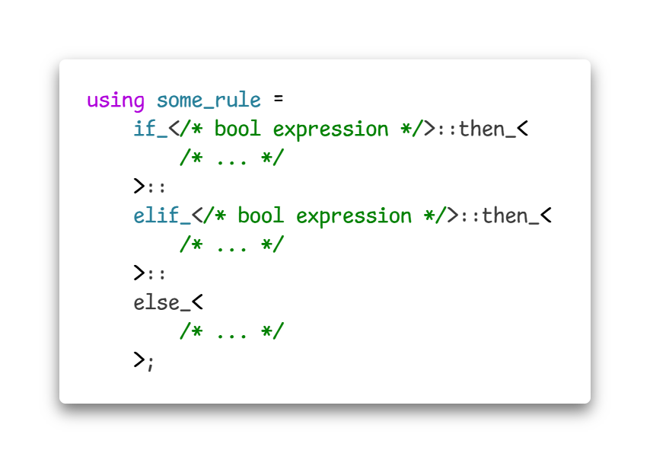
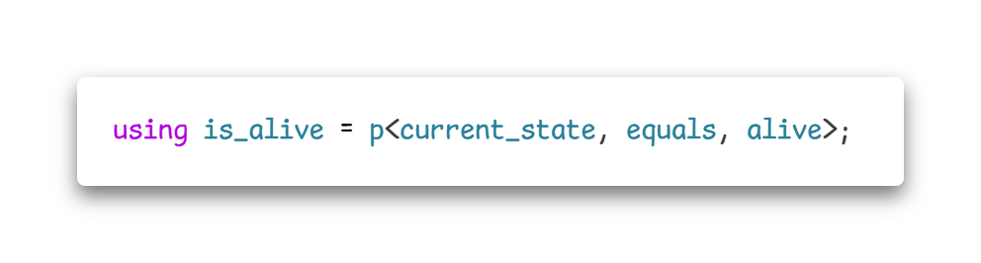
Cellato language
Type-level Expression Language
Nodes ≈ C++ types

Slide 12
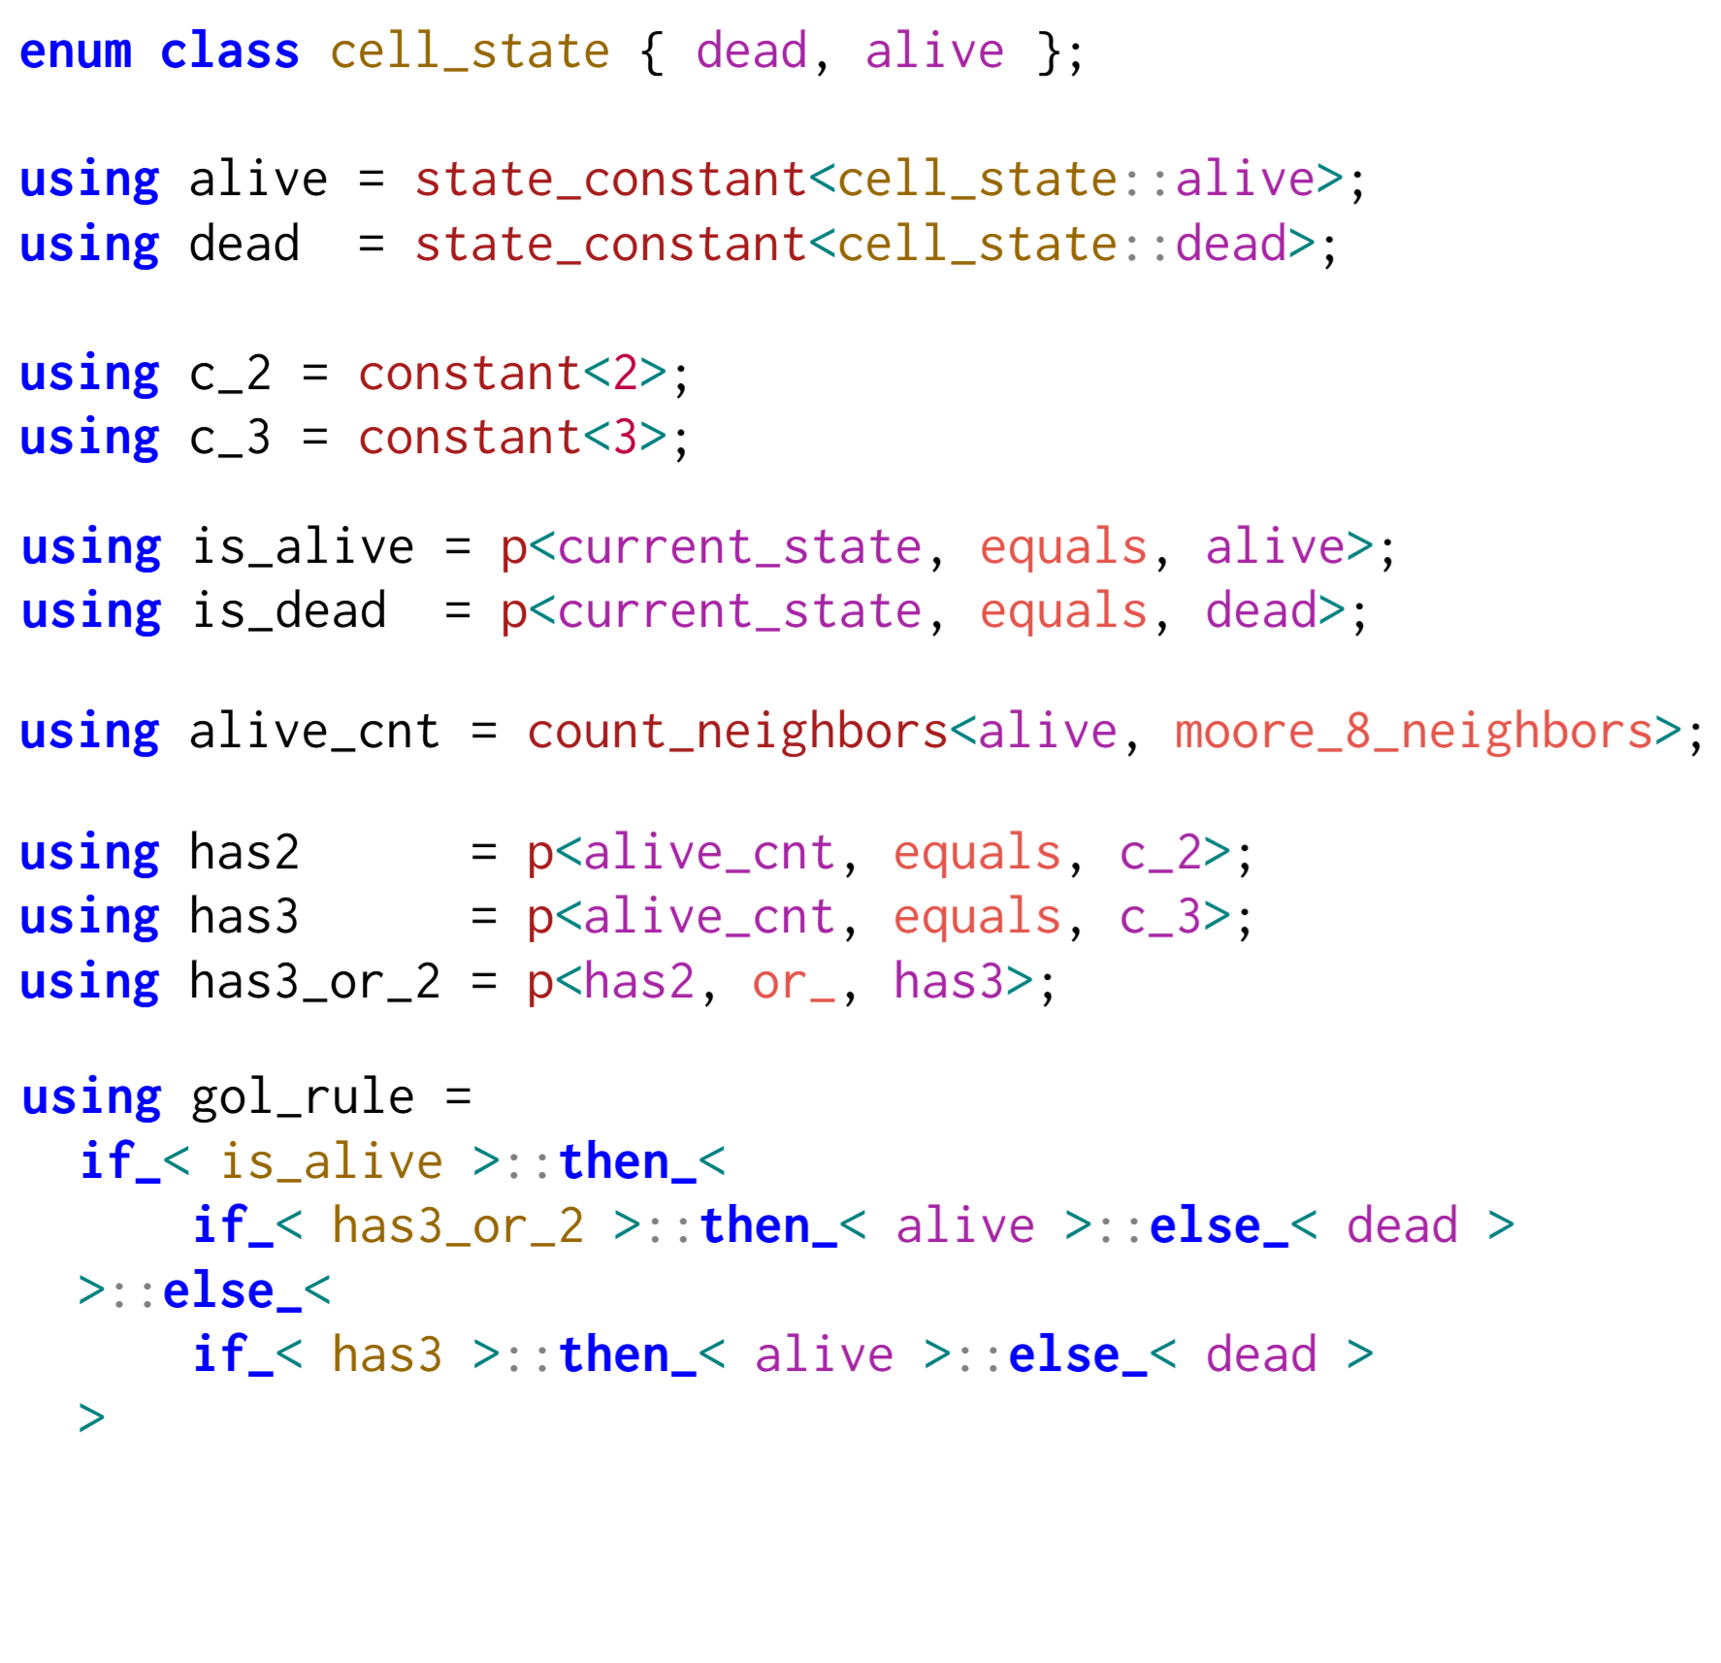
Game of life in Cellato

Slide 13
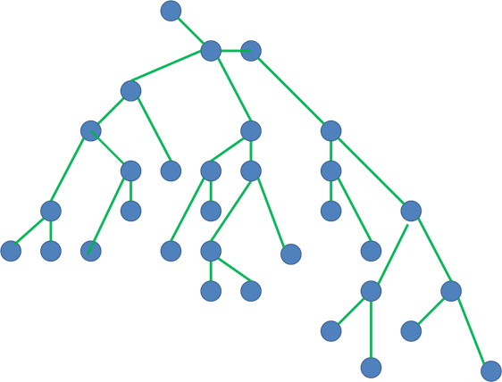
How to evaluate?
C++ types expression tree
???
C++ code computing the rule

Slide 14
Compile time visitor patter
Double dispatch

Slide 15
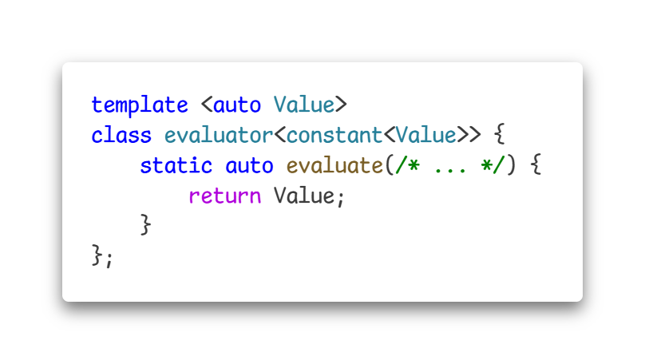
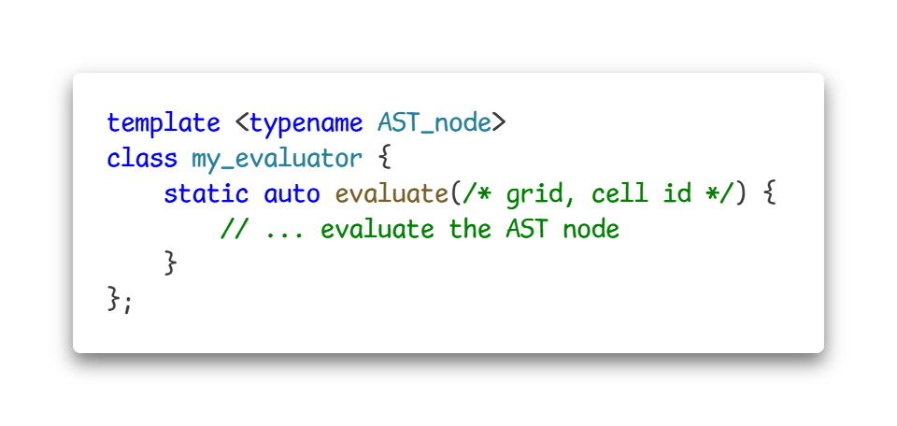
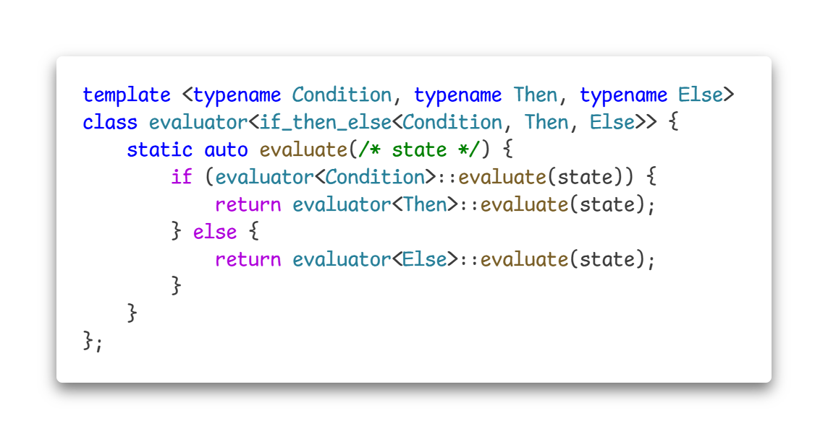
Compile time visitor patter
Double dispatch
Partial specialization

Slide 16
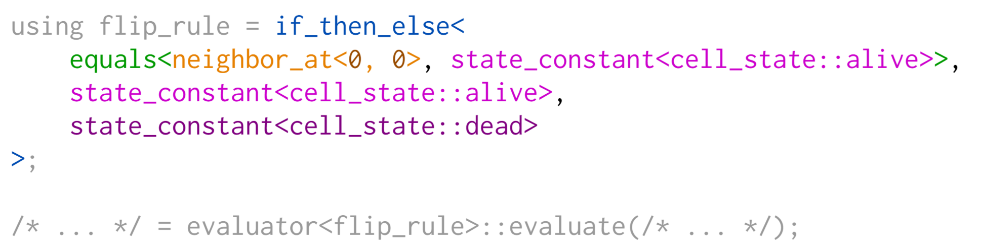
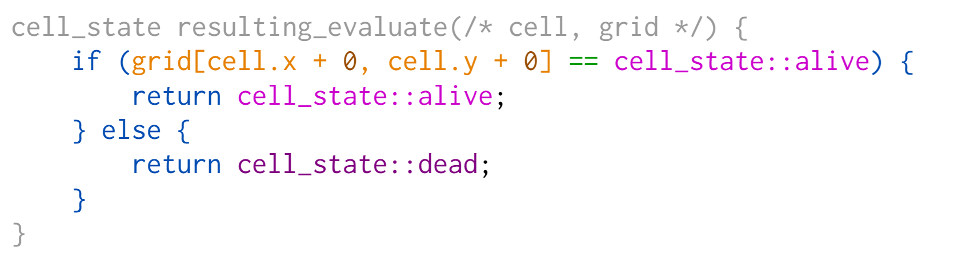
Result ???

Slide 17
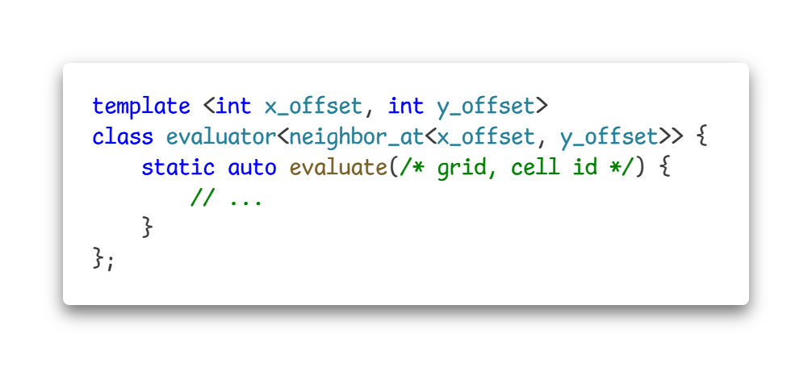
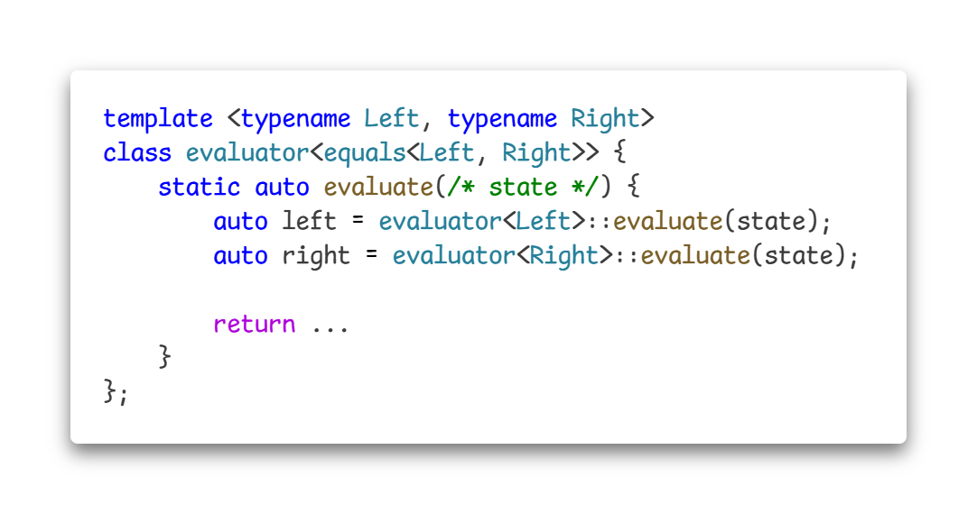
Nice … but why?
Grid layouts

Slide 18
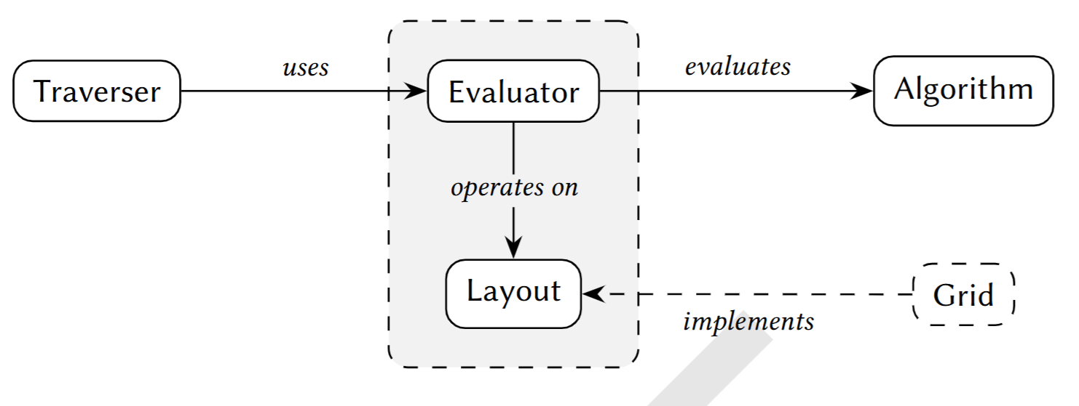
Summary
Cellato’s job

Slide 19
Future Work 🔭
Implement more cellular automata
… extend Cellato
Generalize beyond cellular automata
Wave function collapse
SQL in C++
…
Learn LLM to use Cellato

Slide 20

Thank You
Let’s go to the cafeteria 🍔 ☕

